Slide 1
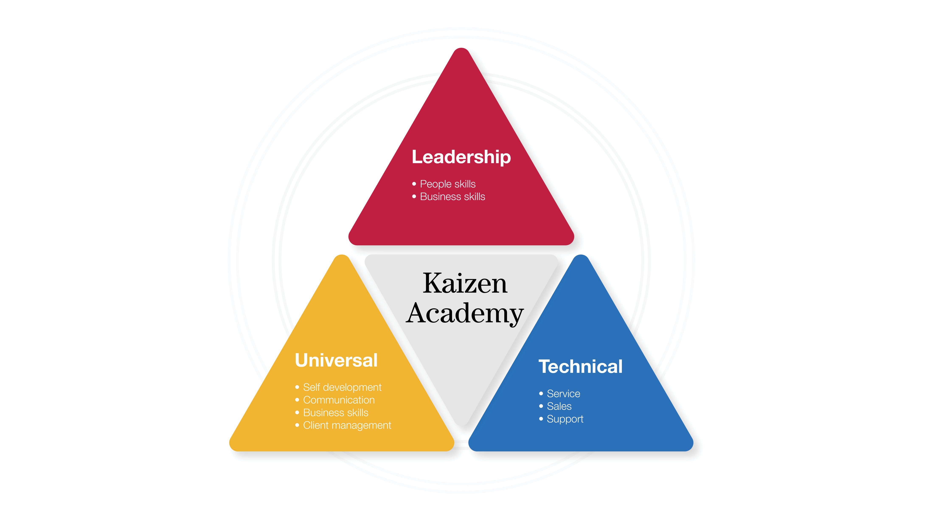
Using data to tell my story

Slide 2
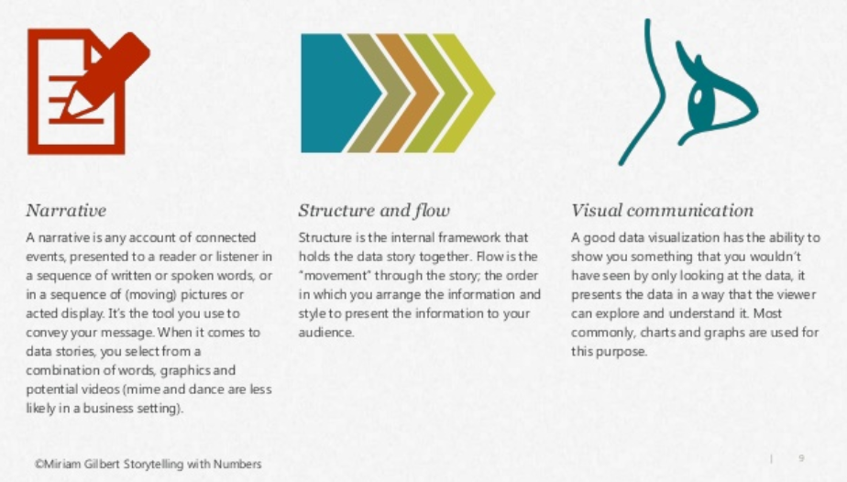
Telling a good story with data
Notes:
Once you’ve understood what your data is telling you, you’ve got to put it into a compelling story to show the same insights to others and drive them to action.
Three components to help you do that: a narrative that goes with your data to set the scene/context for your analysis; the structure and flow of information – think about how each element flows to the next and how you will segue between key points; and visual communication with clearly presented info that is easy to read and understand.
FOR FUTURE LEADERS ONLY: the strength and conditioning exercise that is in Litmos, which follows on from your attendance at this session, is from a blog on decluttering graphs. It shows you how they took a really convoluted graph and cleaned it up step by step – definitely recommend you read!

Slide 3
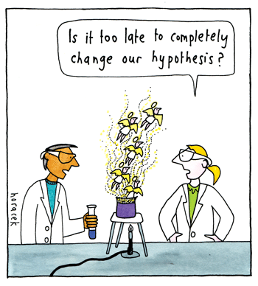
Why do I need data?
So… stakeholders take me seriously
So…. I know I’m solving the right problem
Because… I have a theory about something and I want to prove I’m right
Sometimes it’s easier to show information in a graph than write it in long convoluted sentences that people lose the point of halfway through
… and sometimes data can be the difference between life & death
Notes:
When we go looking for data, we often have a theory or idea about something and want proof we’re right. It also helps our key stakeholders to have faith that our proposal or recommendation is driven by data analysis and consideration rather than gut feel or opinion. A picture/graph tells 1000 words, a well presented argument or business case can say a lot more with charts than loads of words.

Slide 4

Welcome Aboard…
The RMS Titanic

Slide 5

14th April 1912 – 11:40 pm
You are taking an evening stroll on the rear deck enjoying the cold & clean Atlantic sea air.
… Suddenly, the ship lurches you almost lose your footing… something doesn’t seem right…
the next few hours will mean the difference between life and death…
Will you survive the impending disaster?

Slide 6
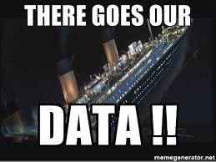
What does the data tell us?
To help answer the burning question… will you live through the night?
We have a set of data from the real titanic disaster.

Slide 7
Before we start a little setup
Open chrome and go to: https://goo.gl/UktT4L

Slide 8
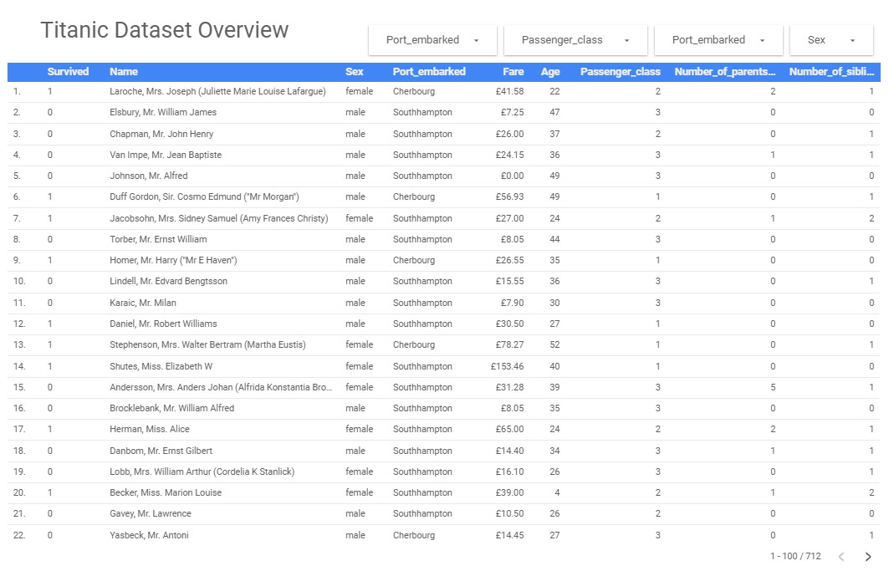
Titanic Data Set

Slide 9
Titanic Data Dictionary
Variable | Definition | Keys
Survived | if the passenger survived | 0 - :( - dead 1 - :) - alive
Name | passenger's full name
Sex | passenger's gender | male or female
Age | passenger's age
Fare | passenger's fare | in British pounds
Passenger class | class passenger is in | 1 – first 2 - second 3 - third
Number of siblings and spouses | number of immediate family
Number of parents and children | number of extended family
Port embarked | Name of the port that the passenger got on

Slide 10
Two types of data
Continuous
Has divisible values (0.9, 0.99, 0.999…)
Measurements
Temperature
Height
100m sprint world record
Prices
Stocks
Crypto-currency
Discrete
Values are categories or round numbers
Categorical
Colour
Gender
Whole Numbers
Number of bedrooms
Number of children

Slide 11


Think of it like this…
Discrete
Continuous
Notes:
Discrete data is when you measure something using groupings/buckets. The item you’re measuring is either in one bucket or another, one step or another (hence the picture), you can’t be on half a step. If you are measuring the colour of M&Ms, they’re either red or blue or green, they can’t be half each. ‘Hit or miss SLA’ is a good business example. It’s one or the other.
Continuous data on the other hand is like being on a ramp, you can be at any point along the ramp, and the way you describe where you are on it can be broken down to more finite and precise measurement depending on how technical you need to be. You can measure your position in kms, metres, centimetres, millimetres, micrometers. Measures like length, speed, weight are good examples of continuous data.
Which do you think is better to collect if you can?
Continuous – it gives you much richer information to draw from. If you just measure ‘hit or miss SLA’, you don’t necessarily know by how much you’ve missed or how well you’ve hit. The solution you might propose to help hit SLA will vary markedly if you’re trying to shave 3 days off your turnaround time as opposed to 3 hours or 3 minutes. You can still break it down to get a ‘hit or miss’ percentage if you want to, but collecting ‘time taken to complete this step’ will give you much greater insight than just stopping at a discrete measure.

Slide 12
Now lets try ourselves
Explore the Titanic data and put it into these two categories
Discrete | Continuous
Notes:
Individual reflection on what measures are available in their team right now. If they don’t have ANY, think about what they SHOULD be collecting.

Slide 13
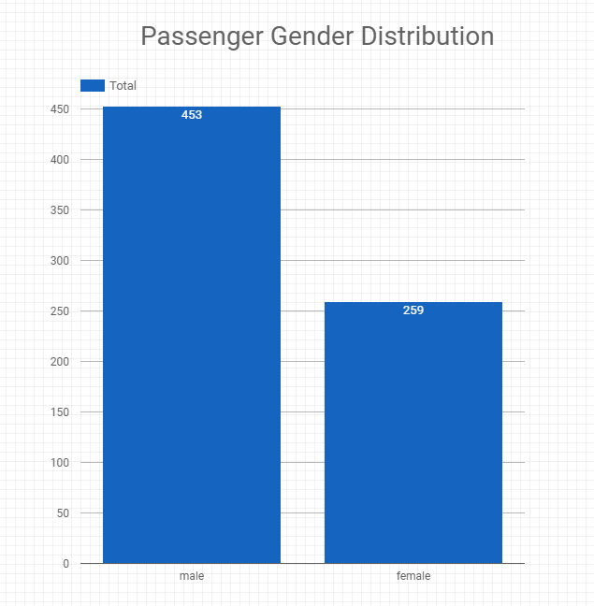
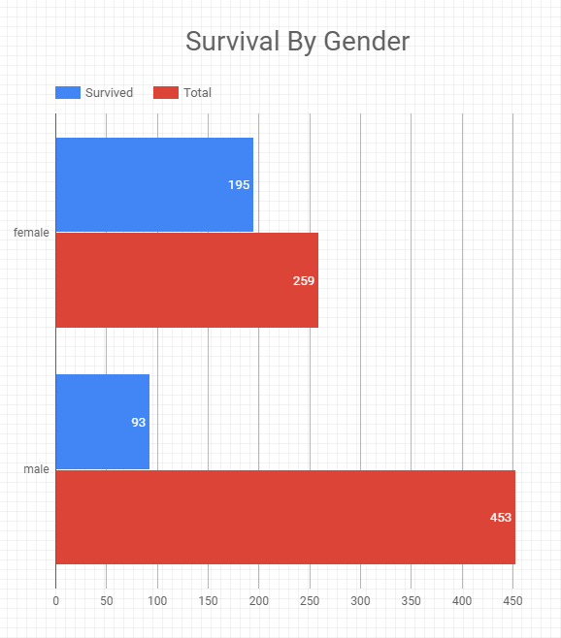
Who was on the Titanic?
Let’s get to know the passengers by plotting some of the discrete data, gender for example.
Notes:
Individual reflection on what measures are available in their team right now. If they don’t have ANY, think about what they SHOULD be collecting.

Slide 14
What we know so far…
Survivor
Most likely female
Casualty
Most likely male
??
??
… sorry guys there is just no room on that door
Notes:
Break into small groups and get them to determine what would be a discrete vs a continuous measure for each of the items.
Eg
Petrol – D: number of times tank was filled, C: litres of petrol consumed
Drinks – D: number of cans emptied, C: millilitres of liquid drunk
Singalong volume – D: too noisy/just right/too loud; C: average decibel level
Luggage – D: number of bags in the car, C: cumulative weight of all bags in kg’s
Enjoyment level – D: unhappy/happy, C: happiness scale from 1-10 (could argue this is still discrete – shows that not everything can be measured in a continuous method)

Slide 15
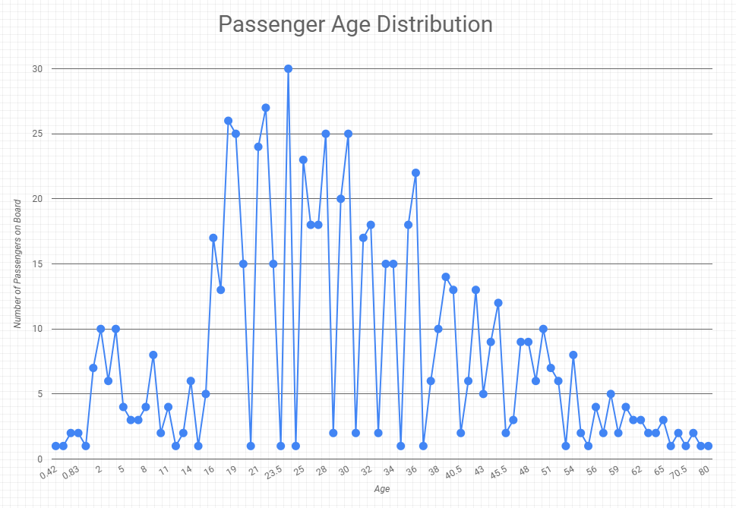
Lets look at a continuous variable
…. This looks a bit weird doesn’t it?
Notes:
Individual reflection on what measures are available in their team right now. If they don’t have ANY, think about what they SHOULD be collecting.

Slide 16
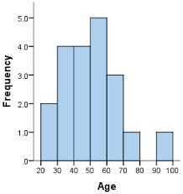
Histogram
Data is grouped into logical ‘buckets’ (x-axis) and the number of examples that fall into each bucket is counted (y-axis)
Think of it like this…
The difference between someone that is 30 and 31 is minor
So lets just group everyone in their 30’s into one group
This just makes it easier to see certain properties of our data.
Used to assess measures of central tendency AND measures of spread
Notes:
Used to show a distribution of your data.. Bit of a strange one, as it takes continuous data and puts it in discrete buckets! But useful for seeing central tendency and spread of your data

Slide 17
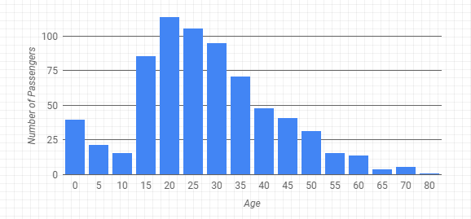
Age as a histogram
That’s better… a lot easier to understand this way
Notes:
Individual reflection on what measures are available in their team right now. If they don’t have ANY, think about what they SHOULD be collecting.

Slide 18
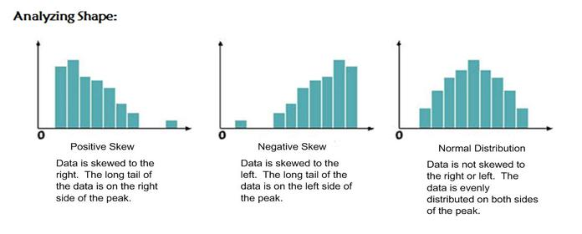
Histogram Shape
Notes:
Typically negative skewed data - cash flow over a quarter, our sales numbers over a quarter as well
Typically positively skewed data is house prices & salaries, most are around the average and then you have a few Altona’s on the harbour, or Bank CEOs salaries that draw the tail out longer
Why do I care?
Different statistical tests apply
Tells you whether a particular problem you’re solving is the ‘exception’ to the norm or whether it’s got an equal likelihood of happening

Slide 19
Age as a histogram
Can you identify the skew in this distribution?
Notes:
Individual reflection on what measures are available in their team right now. If they don’t have ANY, think about what they SHOULD be collecting.

Slide 20
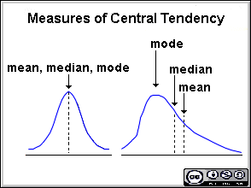
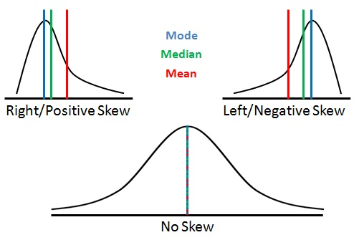
… so how do we compare ages of groups?
Measures of Central Tendency
Mean
average of all values
(sum of all values/number of values)
Median
number in the middle of the data set
average the middle two if you have an even number
Mode
number that occurs most frequently in your data
can have several modes
Notes:
Measures of central tendency are given away in the name – where does your data ‘tend to centre’?
Most common measure is the mean or average, calculated by adding all the values in your data together, and dividing by the number of data points you have. Watch out! Sometimes average is not your friend. It can be skewed by outliers in your data that move it further up or down the spread of your data away from the ‘true’ average. If you’re using the numbers to say ‘this is the usual experience of our customers’ for example, you could be far off the mark.
In that case, you can use the median as a better representation. If you order your data from smallest to largest, the median is the number in the middle of the data set (important to note, it’s not the middle of the data if you’ve ordered it chronologically!). If you have an even number of data points, you take the two middle numbers and average them to arrive at the median. Egs median house price – they use this to represent the ‘usual’ experience of the suburb so it’s not skewed by the $100k shack and the $20m mansion.
Mode is the number that occurs most frequently in your data. Not used as often.

Slide 21
Let’s try it ourselves
Activity 2 - Distribution Centrality
Use the filters to find the mean, median and mode of the age of:
Survivors
Causalities
How do they compare?
What do the results tell you about the skew? (hint look at the bottom diagram)
Now do the same thing with one of the other discrete variables (Class, sex or port embarked)
Notes:
Measures of central tendency are given away in the name – where does your data ‘tend to centre’?
Most common measure is the mean or average, calculated by adding all the values in your data together, and dividing by the number of data points you have. Watch out! Sometimes average is not your friend. It can be skewed by outliers in your data that move it further up or down the spread of your data away from the ‘true’ average. If you’re using the numbers to say ‘this is the usual experience of our customers’ for example, you could be far off the mark.
In that case, you can use the median as a better representation. If you order your data from smallest to largest, the median is the number in the middle of the data set (important to note, it’s not the middle of the data if you’ve ordered it chronologically!). If you have an even number of data points, you take the two middle numbers and average them to arrive at the median. Egs median house price – they use this to represent the ‘usual’ experience of the suburb so it’s not skewed by the $100k shack and the $20m mansion.
Mode is the number that occurs most frequently in your data. Not used as often.

Slide 22
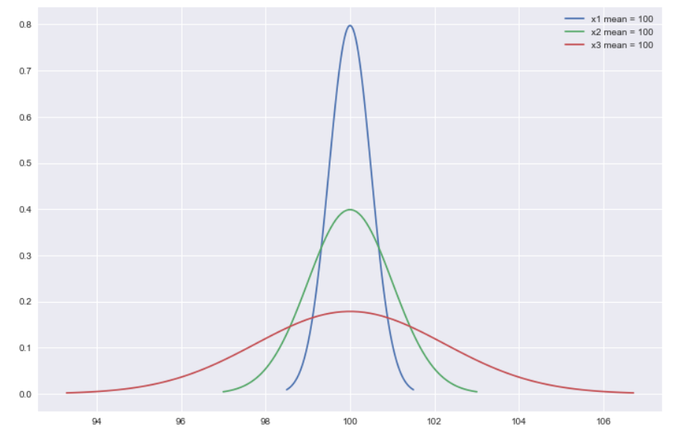
Centrality is not enough
.. If we only relied on centrality we would think these three distributions are the same
Notes:
Never look at measures of central tendency in isolation. Without measures of spread it is difficult to know if the average is a good representation or not.
The range tells you the limits of your data – the largest value minus the smallest value tells you how widespread your data is.
The standard deviation is the best representation of spread. Again the clue is in the name – how much does your data ‘deviate’ from the average? You don’t need to know how to calculate it (excel will do this for you), but you need to be able to interpret it.
A small standard deviation means the data doesn’t deviate very much from your mean, it’s tightly clustered together like the graph on the left. This means your average is more likely to be representative of the typical experience as not many data points differ from it.
A large standard deviation means your data is much more spread out away from the mean and you have much more inconsistency in whatever you are measuring. This means it’s difficult to rely on the average as representative of the typical, as there’s more likelihood that your output will fall on the far ends of your distribution rather than towards the middle.

Slide 23
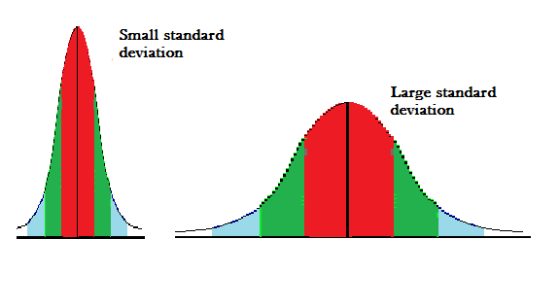
Centrality is just one half of the story
Measures of Spread
Range
Largest value minus smallest value
Standard deviation
Indicates how closely the data is clustered around the mean
Smaller standard deviation indicates a narrow range
Bigger standard deviation indicates a wide range within your data
Notes:
Never look at measures of central tendency in isolation. Without measures of spread it is difficult to know if the average is a good representation or not.
The range tells you the limits of your data – the largest value minus the smallest value tells you how widespread your data is.
The standard deviation is the best representation of spread. Again the clue is in the name – how much does your data ‘deviate’ from the average? You don’t need to know how to calculate it (excel will do this for you), but you need to be able to interpret it.
A small standard deviation means the data doesn’t deviate very much from your mean, it’s tightly clustered together like the graph on the left. This means your average is more likely to be representative of the typical experience as not many data points differ from it.
A large standard deviation means your data is much more spread out away from the mean and you have much more inconsistency in whatever you are measuring. This means it’s difficult to rely on the average as representative of the typical, as there’s more likelihood that your output will fall on the far ends of your distribution rather than towards the middle.

Slide 24
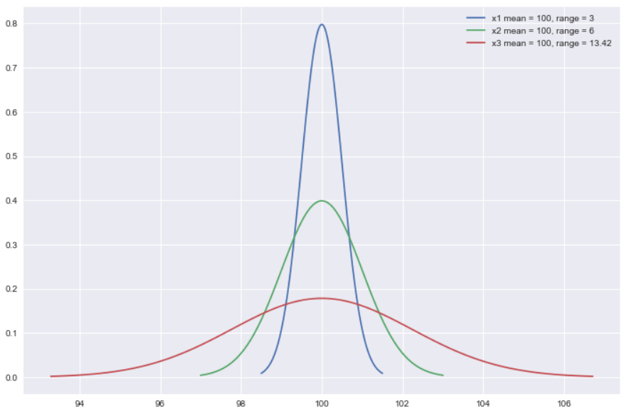
Spread lets us tell them apart
When we add the range, we can see all three are different
Notes:
Never look at measures of central tendency in isolation. Without measures of spread it is difficult to know if the average is a good representation or not.
The range tells you the limits of your data – the largest value minus the smallest value tells you how widespread your data is.
The standard deviation is the best representation of spread. Again the clue is in the name – how much does your data ‘deviate’ from the average? You don’t need to know how to calculate it (excel will do this for you), but you need to be able to interpret it.
A small standard deviation means the data doesn’t deviate very much from your mean, it’s tightly clustered together like the graph on the left. This means your average is more likely to be representative of the typical experience as not many data points differ from it.
A large standard deviation means your data is much more spread out away from the mean and you have much more inconsistency in whatever you are measuring. This means it’s difficult to rely on the average as representative of the typical, as there’s more likelihood that your output will fall on the far ends of your distribution rather than towards the middle.

Slide 25
Let's try it ourselves
Activity 3 - Distribution Spread
Go to Page 5 of the Titanic report
Use the filters to find the standard deviation and range of ages of:
Survivors
Causalities
How do they compare?
Which category has a tighter spread?
Now do the same thing with one of the other discrete variables (Class, sex or port embarked)
Notes:
Measures of central tendency are given away in the name – where does your data ‘tend to centre’?
Most common measure is the mean or average, calculated by adding all the values in your data together, and dividing by the number of data points you have. Watch out! Sometimes average is not your friend. It can be skewed by outliers in your data that move it further up or down the spread of your data away from the ‘true’ average. If you’re using the numbers to say ‘this is the usual experience of our customers’ for example, you could be far off the mark.
In that case, you can use the median as a better representation. If you order your data from smallest to largest, the median is the number in the middle of the data set (important to note, it’s not the middle of the data if you’ve ordered it chronologically!). If you have an even number of data points, you take the two middle numbers and average them to arrive at the median. Egs median house price – they use this to represent the ‘usual’ experience of the suburb so it’s not skewed by the $100k shack and the $20m mansion.
Mode is the number that occurs most frequently in your data. Not used as often.

Slide 26
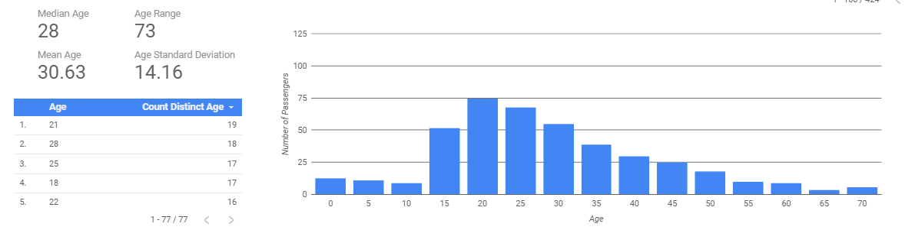
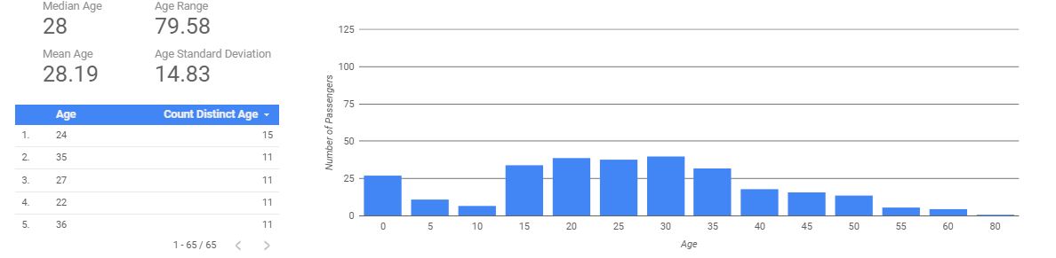
Let’s take a closer look at the results
Survived = 0 (💀)
Survived = 1 (☺)

Slide 27
What we know so far…
Survivor
Most likely female
Casualty
Most likely male
Younger ?
Older ?
… Are we sure yet?
Notes:
Break into small groups and get them to determine what would be a discrete vs a continuous measure for each of the items.
Eg
Petrol – D: number of times tank was filled, C: litres of petrol consumed
Drinks – D: number of cans emptied, C: millilitres of liquid drunk
Singalong volume – D: too noisy/just right/too loud; C: average decibel level
Luggage – D: number of bags in the car, C: cumulative weight of all bags in kg’s
Enjoyment level – D: unhappy/happy, C: happiness scale from 1-10 (could argue this is still discrete – shows that not everything can be measured in a continuous method)

Slide 28
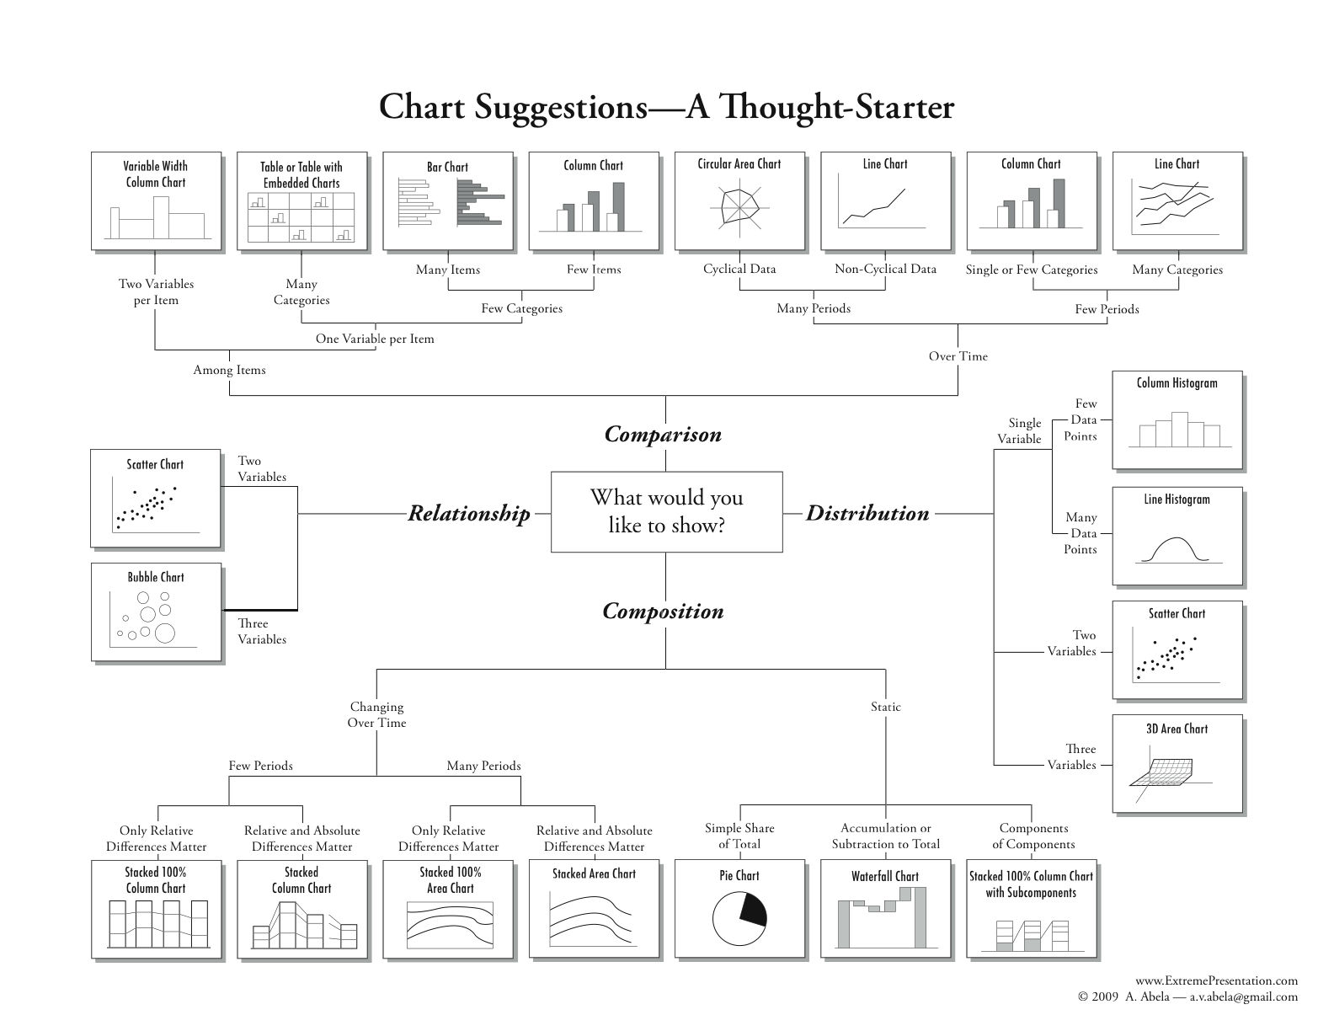
… Choose your charts carefully
Notes:
Don’t be overwhelmed by so many graphs! This is here for future reference.
Main point to understand is that graph choice should be based on what you want to demonstrate with the data. Do you want to show a comparison between teams? Comparison of a team’s performance over time?
Or do you just want to demonstrate the distribution or spread of your data? This can help send the message about inconsistency of performance.
Do you want to show a relationship between two variables? Or the composition of your data? Error types or claim types are a good one – when you’re trying to show the types of information contained within your data.
We’re just going to focus on 3 of the most common graphs that you should familiarise yourself with.

Slide 29
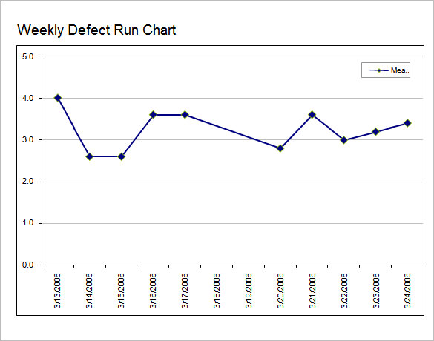
Run or line chart
Compares data over time
Time (minutes, hours, days) is the x-axis
Scale of the variable being measured goes on the y-axis (be careful if you don’t start at zero!)
Plot each data point and join together with a trend line
What’s missing from this example??
You need a measure of central tendency to know whether the variation you’re seeing is good or bad!
Context!
Notes:
A run chart compares data over time. Can see if your data is trending up or down, or inconsistently jumping all over the place.
A pure run chart without a measure of central tendency however, is fairly useless. You don’t have anything to compare it to, to know if the performance you’re looking at is good or bad.
Helpful to know what problem you’re trying to solve… if all your data points are close to the mean, then you’ve got a consistent output. You may then want to look at shifting the average of the entire output. Eg our sales numbers are within 3 deals of the mean every day – consistent which is good. However if the mean is nowhere near the target, then we still have a problem! Need to shift the entire performance up towards the target.
If we have data points varying hugely either side of the mean (such as eg on the slide) then we are inconsistent. Need to get that problem under control first before trying to lift performance, otherwise we might hit target once or twice but will still be inconsistent in hitting it.
The solutions you’d propose to lift performance vs make performance consistent are very different!

Slide 30
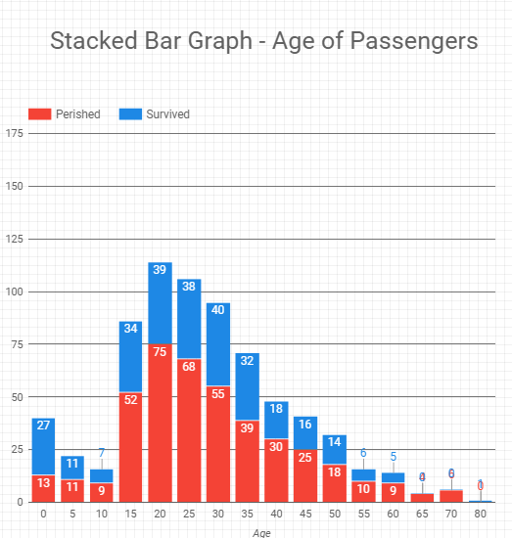
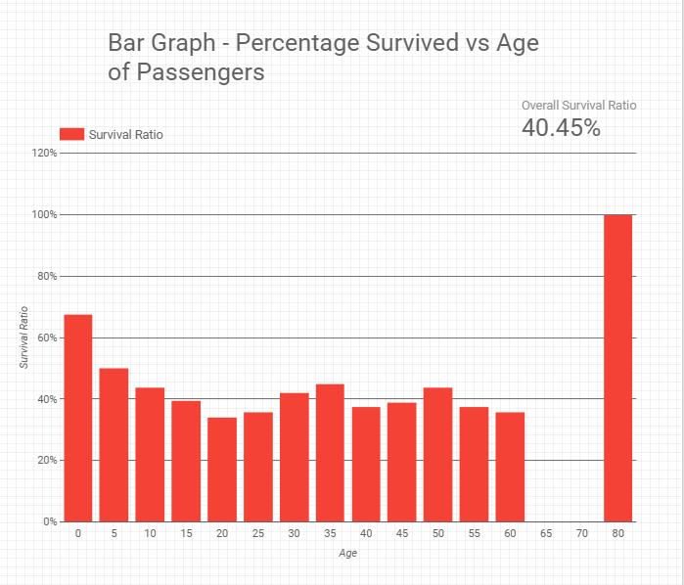
Let’s take another look at age and survival with context
Same data… different ways of representing it… when would you use each of these graphs?

Slide 31
What we know so far…
Survivor
Most likely female
Casualty
Most likely male
Most likely 0 – 10 year of age or in their 30s
Most likely a Teenager, 20’s or older then 50
Notes:
Break into small groups and get them to determine what would be a discrete vs a continuous measure for each of the items.
Eg
Petrol – D: number of times tank was filled, C: litres of petrol consumed
Drinks – D: number of cans emptied, C: millilitres of liquid drunk
Singalong volume – D: too noisy/just right/too loud; C: average decibel level
Luggage – D: number of bags in the car, C: cumulative weight of all bags in kg’s
Enjoyment level – D: unhappy/happy, C: happiness scale from 1-10 (could argue this is still discrete – shows that not everything can be measured in a continuous method)

Slide 32
Was the result expected?
Does the age result make sense?
Why do we see a bump at 50?
Maybe passengers were more likely to let the older go first
Or maybe class has a role to play here and first class passengers are likely to be older

Slide 33
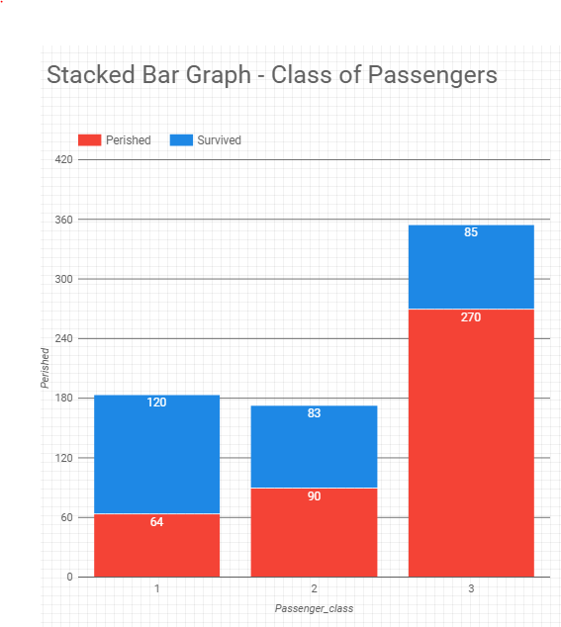
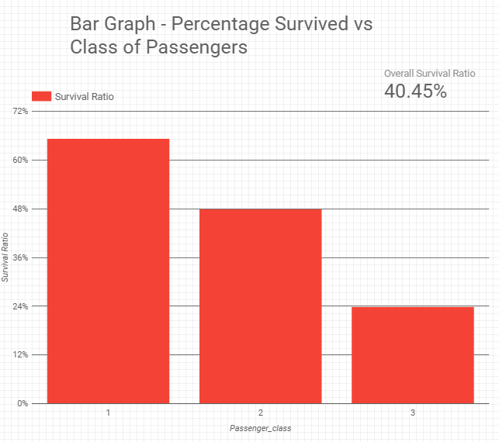
What effect does passenger class have on survival?
What does this show us?

Slide 34

… good thing I am rich or this would be quite the bother

Slide 35
What we know so far…
Survivor
Most likely female
Casualty
Most likely male
Most likely 0 – 10 year of age or in their 30s
Most likely a Teenager, 20’s or older then 50
Most likely First Class Passenger
Most likely Third Class Passenger
Notes:
Break into small groups and get them to determine what would be a discrete vs a continuous measure for each of the items.
Eg
Petrol – D: number of times tank was filled, C: litres of petrol consumed
Drinks – D: number of cans emptied, C: millilitres of liquid drunk
Singalong volume – D: too noisy/just right/too loud; C: average decibel level
Luggage – D: number of bags in the car, C: cumulative weight of all bags in kg’s
Enjoyment level – D: unhappy/happy, C: happiness scale from 1-10 (could argue this is still discrete – shows that not everything can be measured in a continuous method)

Slide 36
How much does each class cost?
To know what our chances of survival were we need to find out which class we would be in…
Lets get an idea of the cost
Our data contains fares and classes
What is a good way of figuring this out?

Slide 37
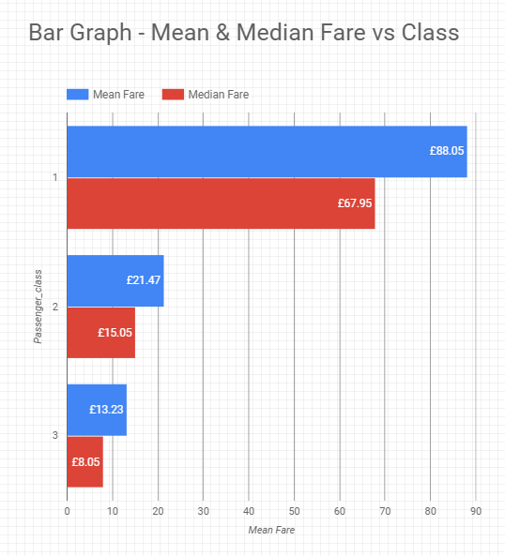
How much does each class cost?
Remember what we learned about measures of centrality
Lets look at the mean and median prices paid by each customer
So now we have an idea of cost
Well looks like we will all be travelling first class…
Or are we

Slide 38
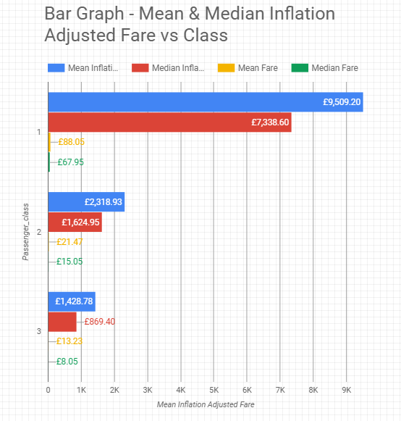
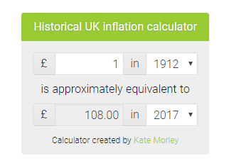
How much does each class cost?
Before we can really make a comparison to ourselves we need to adjust for inflation… remember always think about context
Survival… just got a little bit more expensive

Slide 39
How do we fit in?
Survivor
Most likely female
Casualty
Most likely male
Most likely 0 – 10 year of age or in their 30s
Most likely a Teenager, 20’s or older then 50
Most likely First Class Passenger
Most likely Third Class Passenger
Fare approx. £8,000
Fare approx. £1,000
Based on these profiles, do you think you would be a casualty or a survivor?

Slide 40
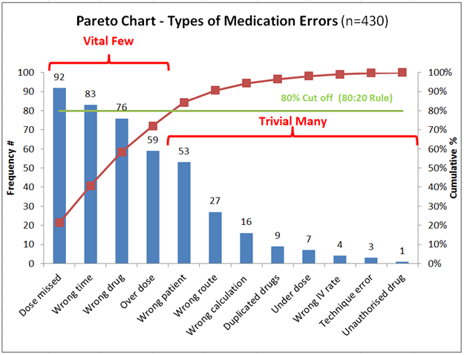
Pareto chart
Ranks data to allow focus
Discrete categories go on the x-axis
Number of items in that category goes on the y-axis
Secondary y-axis measures the cumulative % - when you get to 80% then STOP!
Solve for the vital few, ignore the trivial many (or at least solve later!)
Pareto principle: 20% of the sources cause 80% of any problem.
Notes:
Pareto chart is a composition graph – shows you what types/classifications are within your data. It ranks them from most occurring type, to least occurring type.
Has a second y-axis that shows cumulative % of your data that’s attributed to that type eg in the eg above approx. 20% of the errors are caused by ‘missed dose’ (signified by the red dots) – where you get to 80% of the cumulative, stop! They’re the top few causes to focus on as they’re accounting for the majority of your issues, following the Pareto principle.
Helps to sort out the vital few from the trivial many! No point putting a solution in place for ‘wrong IV rate’ in this example if you do nothing to fix the ‘dose missed’ error type.

Slide 41
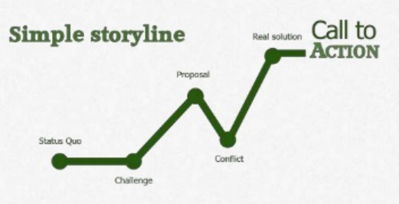
Telling a good story with data
Can you see the storyline in this presentation?
Would you have been as interested if it was just some graphs?
Notes:
A compelling narrative follows this kind of structure: description of current state/status quo, what the challenge is with that status quo (ie why do we need to change?). Then a proposed solution to the challenge, any conflicts that you might have considered as part of the solution (pros and cons, likelihood of success, other ideas considered – shows that you haven’t just picked the first solution you jumped to), then the call to action you need the audience to do for you. Actually ask them “can we go ahead?””do we have your approval to proceed?”etc

Slide 42
Remember this slide?
Survivor
Most likely female
Casualty
Most likely male
Most likely 0 – 10 year of age or in their 30s
Most likely a Teenager, 20’s or older then 50
Most likely First Class Passenger
Most likely Third Class Passenger
Fare approx. £8,000
Fare approx. £1,000
By going back to this through out the story we tie each section back to our main topic.
This reminds the audience where we are going and stops them getting lost in the details
Notes:
Break into small groups and get them to determine what would be a discrete vs a continuous measure for each of the items.
Eg
Petrol – D: number of times tank was filled, C: litres of petrol consumed
Drinks – D: number of cans emptied, C: millilitres of liquid drunk
Singalong volume – D: too noisy/just right/too loud; C: average decibel level
Luggage – D: number of bags in the car, C: cumulative weight of all bags in kg’s
Enjoyment level – D: unhappy/happy, C: happiness scale from 1-10 (could argue this is still discrete – shows that not everything can be measured in a continuous method)

Slide 43

Telling a good story with data
What do you want the audience to do as a result of your presentation?
What does your audience need to know in order to do that?
What does your audience need to feel in order to do that?
Why would your audience want to do what you want them to do?
Notes:
Think about the answers to these questions and make sure your presentation is hitting on these.

